Slide 1
Chapter 2: The human In HCI
To develop usable interface we need to know.
how humans perceive the world around them,
how they store and process information and solve problems, and
how they physically manipulate objects.

Slide 2
The human
Information i/o …
visual, auditory, haptic, movement
Information stored in memory
sensory, short-term, long-term
Information processed and applied
reasoning, problem solving, skill, error
Emotion influences human capabilities
Individual differences

Slide 3
Vision
Two stages in vision
• physical reception of stimulus
• processing and interpretation of stimulus

Slide 4
The Eye - physical reception
mechanism for receiving light and transforming it into electrical energy
light reflects from objects
images are focused upside-down on retina
retina contains rods for low light vision and cones for colour vision
ganglion cells (brain!) detect pattern and movement

Slide 5
Interpreting the signal
Size and depth
visual angle indicates how much of view object occupies (relates to size and distance from eye)
visual acuity is ability to perceive detail (limited)
familiar objects perceived as constant size (in spite of changes in visual angle when far away)
cues like overlapping help perception of size and depth

Slide 6
Interpreting the signal (cont.)
Brightness
subjective reaction to levels of light
affected by luminance of object
measured by just noticeable difference
visual acuity increases with luminance as does flicker
Colour
made up of hue, intensity, saturation
cones sensitive to colour wavelengths
blue acuity is lowest
8% males and 1% females colour blind

Slide 7
Interpreting the signal (cont.)
The visual system compensates for:
movement
changes in luminance.
Context is used to resolve ambiguity
Optical illusions sometimes occur due to over compensation

Slide 8
Optical Illusions
The Muller Lyer illusion
is a well-known optical illusion in which two lines of the same length appear to be of different lengths.
The Ponzo illusion
He suggested that the human mind judges an object's size based on its background.

Slide 9
Reading
Several stages:
visual pattern perceived
decoded using internal representation of language
interpreted using knowledge of syntax, semantics, pragmatics
Reading involves saccades and fixations
Perception occurs during fixations
Word shape is important to recognition
Negative contrast improves reading from computer screen

Slide 10
Hearing
Provides information about environment: distances, directions, objects etc.
Physical apparatus:
outer ear – protects inner and amplifies sound
middle ear – transmits sound waves as vibrations to inner ear
inner ear – chemical transmitters are released and cause impulses in auditory nerve
Sound
pitch – sound frequency
loudness – amplitude
Timbre/resonance – type or quality

Slide 11
Hearing (cont.)
Humans can hear frequencies from 20Hz to 15kHz
less accurate distinguishing high frequencies than low.
Auditory system filters sounds
can attend to sounds over background noise.
for example, the cocktail party phenomenon.

Slide 12
Touch
Provides important feedback about environment.
May be key sense for someone who is visually impaired.
Stimulus received via receptors in the skin:
thermoreceptors – heat and cold
nociceptors – pain
mechanoreceptors – pressure (some instant, some continuous)
Some areas more sensitive than others e.g. fingers.
Kinesthesis - awareness of body position
affects comfort and performance.

Slide 13
Movement
Time taken to respond to stimulus: reaction time + movement time
Movement time dependent on age, fitness etc.
Reaction time - dependent on stimulus type:
visual ~ 200ms
auditory ~ 150ms
pain ~ 700ms

Slide 14
Movement (cont.)
Fitts' Law describes the time taken to hit a screen target:
Mt = a + b log₂(D/S + 1)
where: a and b are empirically determined constants
Mt is movement time
D is Distance
S is Size of target
targets as large as possible distances as small as possible

Slide 15
Memory
There are three types of memory function:
Sensory memories
Short-term memory or working memory
Long-term memory
Selection of stimuli governed by level of arousal.
Attention
Rehearsal

Slide 16
sensory memory
Buffers for stimuli received through senses
iconic memory: visual stimuli
echoic memory: aural stimuli
haptic memory: tactile stimuli

Slide 17
Short-term memory (STM)
Scratch-pad for temporary recall
rapid access ~ 70ms
rapid decay ~ 200ms
limited capacity - 7± 2 chunks

Slide 18
Examples
212348278493202
0121 414 2626
HEC ATR ANU PTH ETR EET

Slide 19
Long-term memory (LTM)
Repository for all our knowledge
slow access ~ 1/10 second
slow decay, if any
huge or unlimited capacity
Two types
episodic – serial memory of events
semantic – structured memory of facts, concepts, skills
semantic LTM derived from episodic LTM

Slide 20
Long-term memory (cont.)
Semantic memory structure
provides access to information
represents relationships between bits of information
supports inference
Model: semantic network
inheritance – child nodes inherit properties of parent nodes
relationships between bits of information explicit
supports inference through inheritance

Slide 21
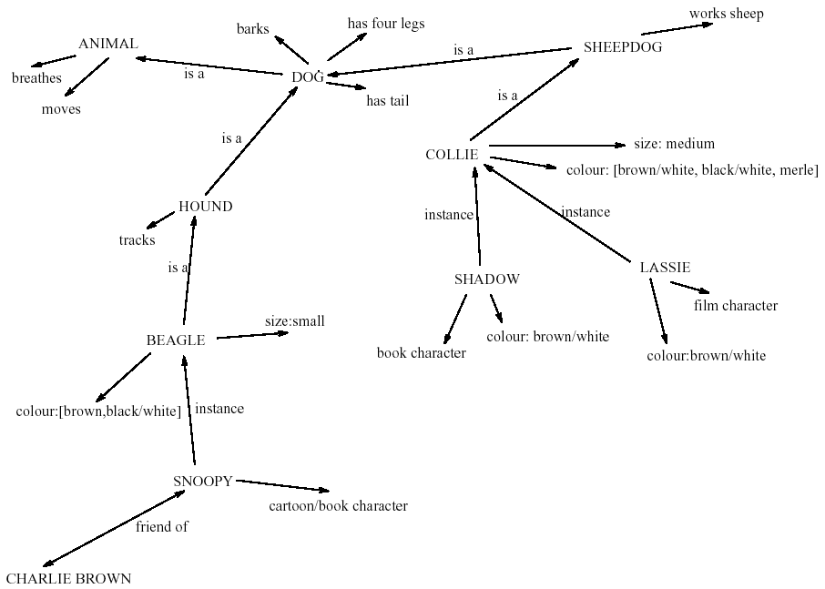
LTM - semantic network

Slide 22
Models of LTM - Frames
Information organized in data structures
Slots in structure instantiated with values for instance of data
Type–subtype relationships
DOG
Fixed
legs: 4
Default
diet: carnivorous
sound: bark
Variable
size: color
COLLIE
Fixed
breed of: DOG
type: sheepdog
Default
size: 65 cm
Variable
color

Slide 23
Models of LTM - Scripts
Model of stereotypical information required to interpret situation
Script has elements that can be instantiated with values for context
Script for a visit to the vet
Entry conditions: dog ill
vet open
owner has money
Result: dog better
owner poorer
vet richer
Props: examination table
medicine
instruments
Roles: vet examines
diagnoses
treats
owner brings dog in
pays
takes dog out
Scenes: arriving at reception
waiting in room
examination
paying
Tracks: dog needs medicine
dog needs operation

Slide 24
Models of LTM - Production rules
Representation of procedural knowledge.
Condition/action rules
if condition is matched
then use rule to determine action.
IF dog is wagging tail
THEN pat dog
IF dog is growling
THEN run away

Slide 25
LTM - Storage of information
rehearsal
information moves from STM to LTM
total time hypothesis
amount retained proportional to rehearsal time
distribution of practice effect
optimized by spreading learning over time
structure, meaning and familiarity
information easier to remember

Slide 26
LTM - Forgetting
decay
information is lost gradually but very slowly
interference
new information replaces old: retroactive interference
old may interfere with new: proactive inhibition
so may not forget at all memory is selective …
… affected by emotion – can subconsciously `choose' to forget

Slide 27
LTM - retrieval
recall
information reproduced from memory can be assisted by cues, e.g. categories, imagery
recognition
information gives knowledge that it has been seen before
less complex than recall - information is cue

Slide 28
Do You Want to a Play Game?

Slide 29
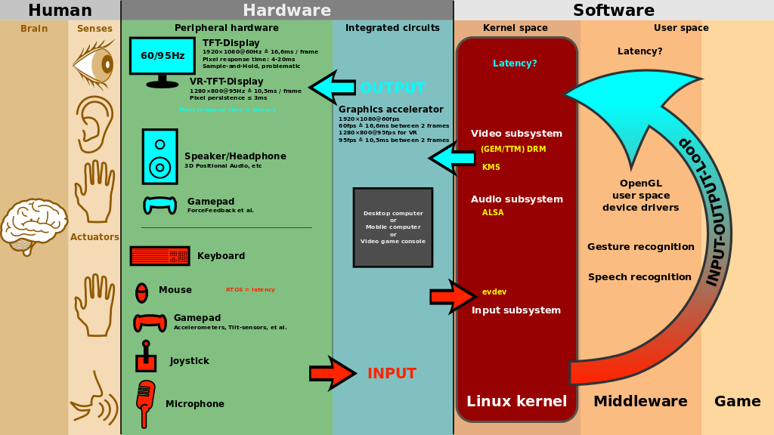

Slide 30
Thinking
Reasoning
deduction, induction, abduction
Problem solving

Slide 31
Deductive Reasoning
Deduction:
derive logically necessary conclusion from given premises.
e.g. If it is Friday then she will go to work
It is Friday
Therefore she will go to work.
Logical conclusion not necessarily true:
e.g. If it is raining then the ground is dry
It is raining
Therefore the ground is dry

Slide 32
Deduction (cont.)
When truth and logical validity clash …
e.g. Some people are babies
Some babies cry
Inference - Some people cry
Correct?
People bring world knowledge to bear

Slide 33
Inductive Reasoning
Induction:
generalize from cases seen to cases unseen
e.g. all elephants we have seen have trunks therefore all elephants have trunks.
Unreliable:
can only prove false not true
… but useful!
Humans not good at using negative evidence
e.g. Wasson's cards.

Slide 34
Wasson's cards
7 E 4 K
If a card has a vowel on one side it has an even number on the other
Is this true?
How many cards do you need to turn over to find out?
…. and which cards?

Slide 35
Abductive reasoning
reasoning from event to cause
e.g. Sam drives fast when drunk.
If I see Sam driving fast, assume drunk.
Unreliable:
can lead to false explanations

Slide 36
Problem solving
Process of finding solution to unfamiliar task using knowledge.
Several theories.
Gestalt
problem solving both productive and reproductive
productive draws on insight and restructuring of problem
attractive but not enough evidence to explain `insight' etc.
move away from behaviourism and led towards information processing theories

Slide 37
Problem solving (cont.)
Problem space theory
problem space comprises problem states
problem solving involves generating states using legal operators
heuristics may be employed to select operators e.g. means-ends analysis
operates within human information processing system e.g. STM limits etc.
largely applied to problem solving in well-defined areas e.g. puzzles rather than knowledge intensive areas

Slide 38
Problem solving (cont.)
Analogy
analogical mapping:
novel problems in new domain?
use knowledge of similar problem from similar domain
analogical mapping difficult if domains are semantically different
Skill acquisition
skilled activity characterized by chunking
lot of information is chunked to optimize STM
conceptual rather than superficial grouping of problems
information is structured more effectively

Slide 39
Errors and mental models
Types of error
slips
right intention, but failed to do it right
causes: poor physical skill, inattention etc.
change to aspect of skilled behaviour can cause slip
mistakes
wrong intention
cause: incorrect understanding
humans create mental models to explain behaviour.
if wrong (different from actual system) errors can occur

Slide 40
Emotion
Various theories of how emotion works
James-Lange: emotion is our interpretation of a physiological response to a stimuli
Cannon: emotion is a psychological response to a stimuli
Schacter-Singer: emotion is the result of our evaluation of our physiological responses, in the light of the whole situation we are in
Emotion clearly involves both cognitive and physical responses to stimuli

Slide 41
Emotion (cont.)
The biological response to physical stimuli is called affect
Affect influences how we respond to situations
positive → creative problem solving
negative → narrow thinking
“Negative affect can make it harder to do even easy tasks; positive affect can make it easier to do difficult tasks”
(Donald Norman)

Slide 42
Emotion (cont.)
Implications for interface design
stress will increase the difficulty of problem solving
relaxed users will be more forgiving of shortcomings in design
aesthetically pleasing and rewarding interfaces will increase positive affect

Slide 43
Individual differences
long term – sex, physical and intellectual abilities
short term – effect of stress or fatigue
changing – age
Ask yourself: will design decision exclude section of user population?

Slide 44
Summary on Humans
Humans are limited in their capacity to process information. This has important implications for design.
Information is received and responses given via a number of input and output channels:
visual channel
auditory channel
haptic channel
movement.

Slide 45
Summary on Humans
Information is stored in memory:
sensory memory
short-term (working) memory
long-term memory.
Information is processed and applied:
reasoning
problem solving
skill acquisition
error.
Emotion influences human capabilities.
Users share common capabilities but are individuals with differences, which should not be ignored.

